Slide 1

Introduction to Artificial Intelligence
Tim ajar Kecerdasan artificial

Slide 2

Agenda
Lesson plan
Grading methods
Introduction of Artificial intelligence

Slide 3
Lesson plan- Uts
No | Materi
1 | Introduction to Artificial Intelligence
2 | Fundamental Use Cases for Artificial Intelligence
3 | Machine Learning Pipelines
4 | Feature Selection and Feature Engineering
5 | Kuis1 Jurnal presentation (2 orang)
6 | Classification and Regression Using Supervised Learning
7 | Predictive Analytics with Ensemble Learning
8 | Detecting Patterns with Unsupervised Learning
9 | UTS. Essay

Slide 4
Lesson plan – Uts - UAS
No | Materi
10 | Logic Programming
11 | Heuristic Search Techniques
12 | Natural Language Processing
13 | Sequential Data and Time Series Analysis
14 | Quis 2 Literatur review(2 orang) minimal 10 paper internasional
15 | Neural Networks
16 | Recurrent Neural Networks and Other Deep Learning Models
17 | UAS Pilihan Ganda

Slide 5

Grading
participation
Quiz 1
Mid test
Quiz 2
Final test
10 %
20 %
25 %
20 %
25 %

Slide 6
Main reference
Artasanchez, Alberto & Joshi, Prateek. 2020. Artificial Intelligence with Python 2nd Edition. Packt Publishing Ltd.

Slide 7

Describe AI in a word!

Slide 8
Mention the application of AI around you

Slide 9

Learning outcome
Kuliah ini akan membahas konsep kecerdasan buatan (AI) dan bagaimana penerapannya dalam dunia nyata.

Slide 10

what is “INTELLIGENCE”?
Notes:
kemampuan yang digunakan untuk memahami informasi, memecahkan masalah, dan membentuk pengetahuan dan kesadaran serta menciptakan produk-produk dan karya-karya

Slide 11
ARtIFICIAL INTELLIGENCE?
Definition: “a field of computer science that studies how machines can perform tasks that usually require humans”
Definition “a field of computer science that studies how machines can imitate human intelligence.”
AI is a branch of science that studies how the human brain works. With AI, we try to mirror some of the systems and mechanisms of the brain in computing, and in doing so we draw inspiration from, and interact with, fields such as neuroscience."
Notes:
Definisi “bidang ilmu komputer yang mempelajari bagaimana mesin dapat melakukan tugas-tugas yang biasanya membutuhkan peran manusia”
Definisi “bidang ilmu komputer yang mempelajari bagaimana mesin dapat meniru kecerdasan manusia.”
“AI merupakan salah satu cabang ilmu pengetahuan yang mempelajari cara kerja otak manusia. Dengan AI, kita mencoba mencerminkan beberapa sistem dan mekanisme otak dalam komputasi, dan dengan demikian kita mendapatkan inspirasi, dan berinteraksi dengan, bidang-bidang seperti ilmu saraf.”

Slide 12
We can recognize objects, understand languages, learn new things, and perform many more sophisticated tasks with our brain. How does the human brain do this?

Slide 13
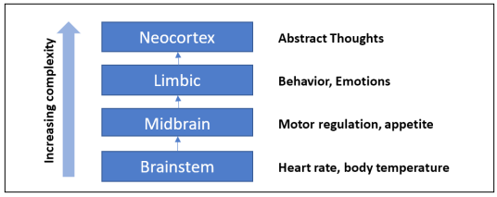
Basic brain components
Notes:
Brainstem – batang otak, mengatur fungsi otonom mendasar: detak jantung, suhu tubuh
Mid brain – otak tengah, mengontrol fungsi motoric penglihatan, pendengaran
Limbic – tingkah laku dan emosi
Neocortex – penalaran spasial, bahasa dll

Slide 14
Mengapa kita perlu mempelajari AI?
AI can impact every aspect of our lives.
The field of AI tries to understand patterns and behaviors of entities.
With AI, we want to build smart systems and understand the concept of intelligence as well.
The intelligent systems that we construct are very useful in understanding how an intelligent system like our brain goes about constructing another intelligent system.
to automate many things

Slide 15
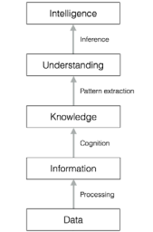
how raw data gets converted into intelligence
Notes:
Data: Kumpulan fakta
Informasi: data yang dilengkapi dengan deskripsi/ada konteksnya
Knowledge: informasi yang dikumpulkan dari waktu ke waktu
Understanding: pemahaman terhadap pengetahuan yang dimiliki
Intelligence: kemampuan memecahkan masalah

Slide 16
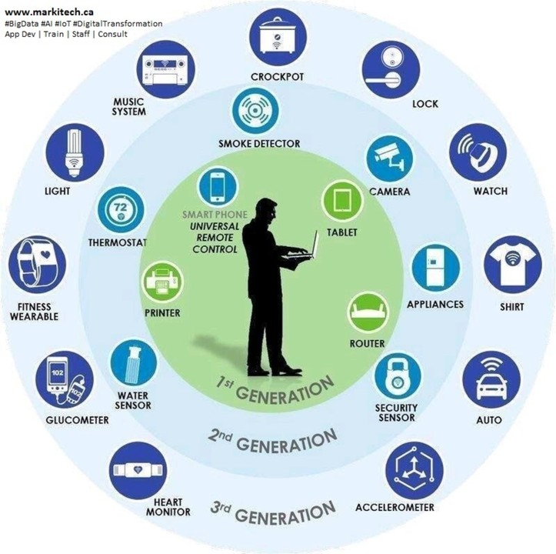
We live in a world where:
We deal with huge and insurmountable amounts of data. The human brain can't keep track of so much data.
Data originates from multiple sources simultaneously. The data is unorganized and chaotic.
Knowledge derived from this data must be updated constantly because the data itself keeps changing.
The sensing and actuation must happen in real-time with high precision.

Slide 17
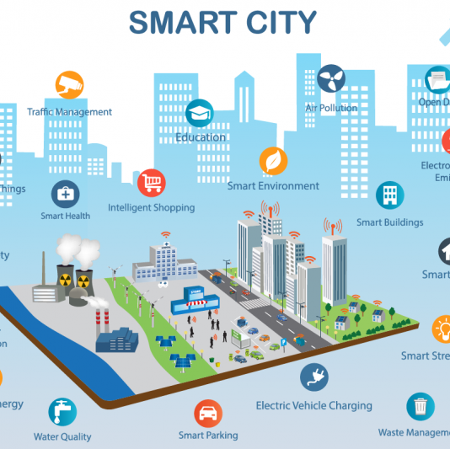
We need AI systems that can
Handle large amounts of data in an efficient way. With the advent of Cloud Computing, we are now able to store huge amounts of data.
Ingest data simultaneously from multiple sources without any lag. Index and organize data in a way that allows us to derive insights.
Learn from new data and update constantly using the right learning algorithms. Think and respond to situations based on the conditions in real time.
Continue with tasks without getting tired or needing breaks

Slide 18
Branches of AI
Machine learning and pattern recognition
Logic-based AI
Search
Knowledge representation
Planning
Heuristics
Genetic programming

Slide 19
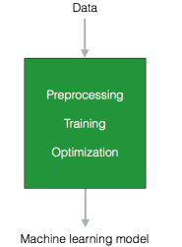
Machine learning and pattern recognition
This is perhaps the most popular form of AI out there.
We design and develop software that can learn from data.
Based on these learning models, we perform predictions on unknown data.
One of the main constraints here is that these programs are limited to the power of the data.
Notes:
Supervised dan unsupervised

Slide 20
Logic-based AI
Mathematical logic is used to execute computer programs in logic-based AI.
A program written in logic-based AI is basically a set of statements in logical form that expresses facts and rules about a problem domain.
This is used extensively in pattern matching, language parsing, semantic analysis, and so on
Notes:
Logika fuzzy, forward chaining dll

Slide 21
Search
Search techniques are used extensively in AI programs.
These programs examine many possibilities and then pick the most optimal path.
For example, this is used a lot in strategy games such as chess, networking, resource allocation, scheduling, and so on
Notes:
catur

Slide 22
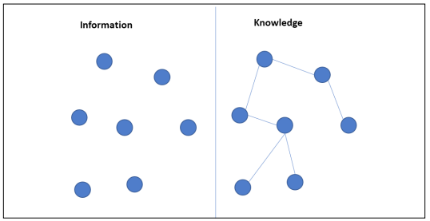
Knowledge representation
The facts about the world around us need to be represented in some way for a system to make sense of them.
The languages of mathematical logic are frequently used here.
If knowledge is represented efficiently, systems can be smarter and more intelligent.
Ontology is a closely related field of study that deals with the kinds of objects that exist
Notes:
Silogisme, sistem pakar

Slide 23
Planning
This field deals with optimal planning that gives us maximum returns with minimal costs.
These software programs start with facts about the situation and a statement of a goal.
These programs are also aware of the facts of the world, so that they know what the rules are.
Notes:
Vehichel routing problem

Slide 24
Heuristics
A heuristic is a technique used to solve a given problem that's practical and useful in solving the problem in the short term, but not guaranteed to be optimal.
This is more like an educated guess on what approach we should take to solve a problem.
In AI, we frequently encounter situations where we cannot check every single possibility to pick the best option.
Notes:
Lebih advanced dari search, biasanya ada constraint tertentu

Slide 25
Genetic programming
Genetic programming is a way to get programs to solve a task by mating programs and selecting the fittest.
The programs are encoded as a set of genes, using an algorithm to get a program that can perform the given task well

Slide 26
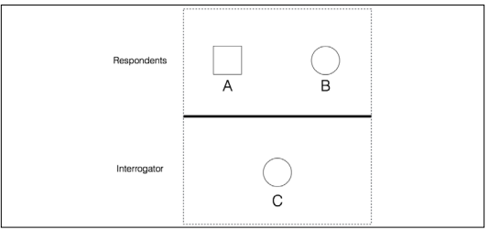
Defining intelligence using the Turing test
The legendary computer scientist and mathematician, Alan Turing, proposed the Turing test to provide a definition of intelligence.
It is a test to see if a computer can learn to mimic human behavior. He defined intelligent behavior as the ability to achieve human-level intelligence during a conversation.
This performance should be enough to trick an interrogator into thinking that the answers are coming from a human.
Notes:
The imitation game

Slide 27
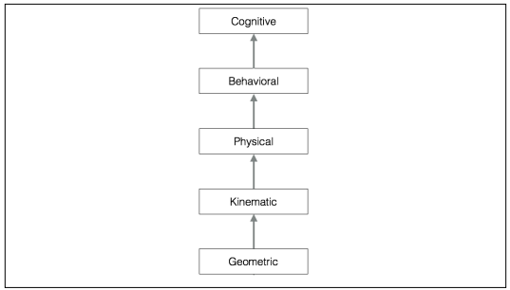
Making machines think like humans
Within computer science, there is a field of study called Cognitive Modeling that deals with simulating the human thinking process. It tries to understand how humans solve problems. It takes the mental processes that go into this problemsolving process and turns it into a software model. This model can then be used to simulate human behavior.

Slide 28
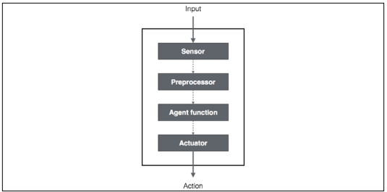
rational agents

Slide 29
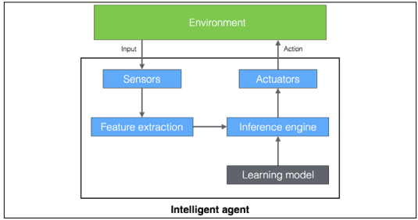
intelligent agent
Notes:
Membuat keputusan

Slide 30
Thank

